Slide 1
Microsoft Band: Developing for Microsoft Band and Microsoft Health
Oleksandr Krakovetskyi @msugvnua
CEO, DevRain Solutions

Slide 2
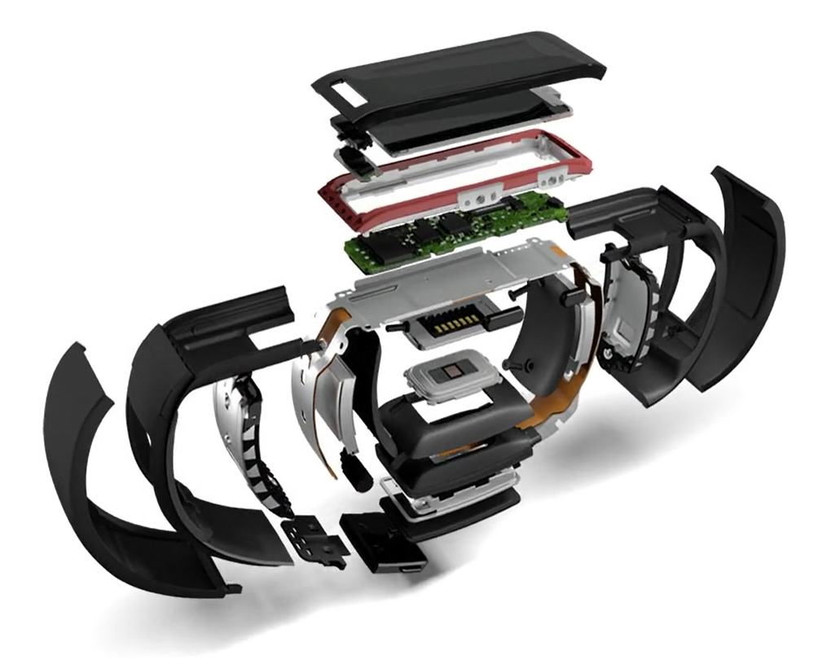
#include “agenda.h”
What is Microsoft Band & Health?
Interacting with Microsoft Band
Interacting with Microsoft Health
Q&A

Slide 3
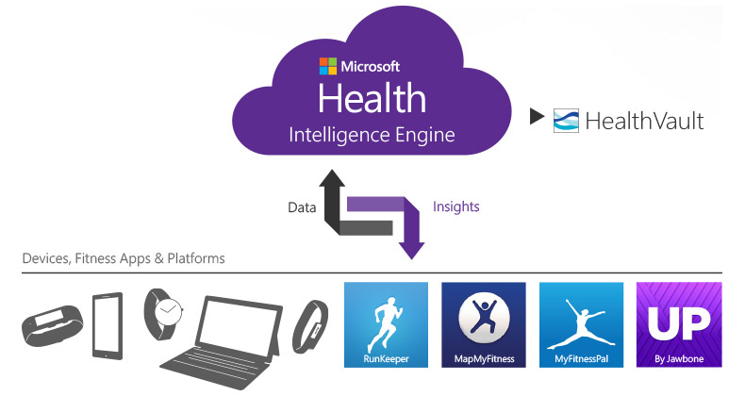
Microsoft Health
Microsoft Health is a cloud-based service that helps you live healthier by providing actionable insights based on data gathered from the fitness devices and apps that you use every day. Activity-tracking devices like the new Microsoft Band, smart watches, and mobile phones plus services like RunKeeper or MyFitnessPal connect easily to Microsoft Health. Using this fitness data and our Intelligence Engine in the cloud, Microsoft Health provides valuable, personal insights so you can reach your fitness goals.

Slide 4
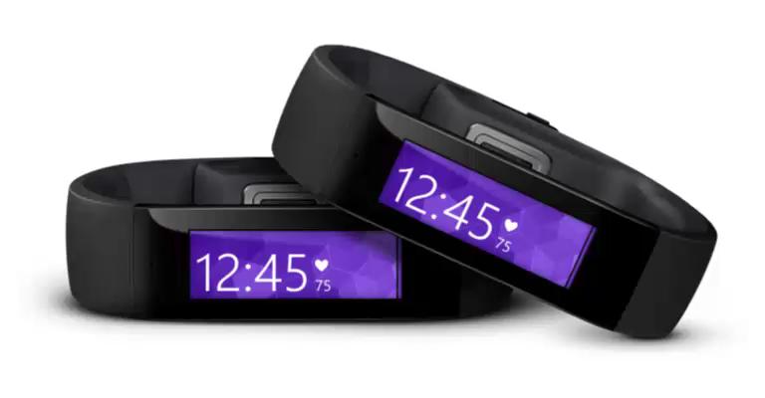
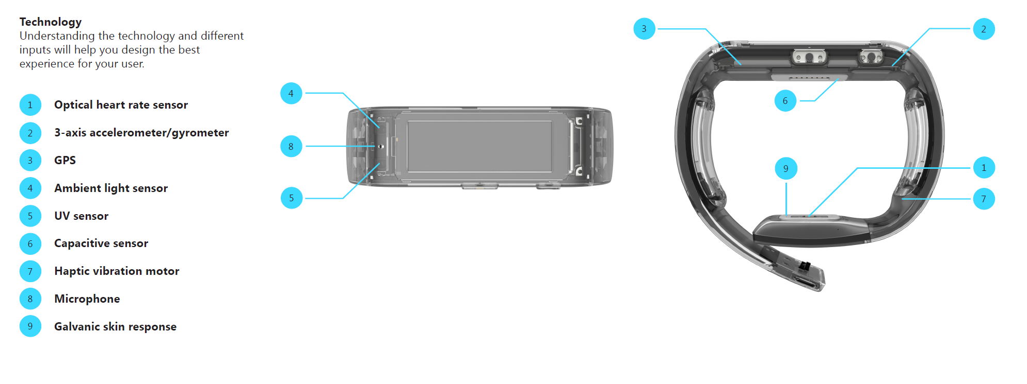
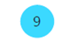
Microsoft Band
All day wearable device
Live healthier
Be more productive
Stay connected at a glance
Advanced Technology
10 sensors
Touch display
2 days+ battery life
10
10
Gyroscope

Slide 5
Microsoft Band Sensors
Optical heart rate monitor
3-axis accelerometer
GPS
Ambient Light Sensor
UV sensor
Capacitive sensor
Haptic vibration motor
Microphone
Galvanic Skin Response (GSR)
Gyroscope

Slide 6



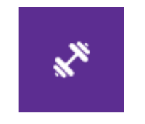
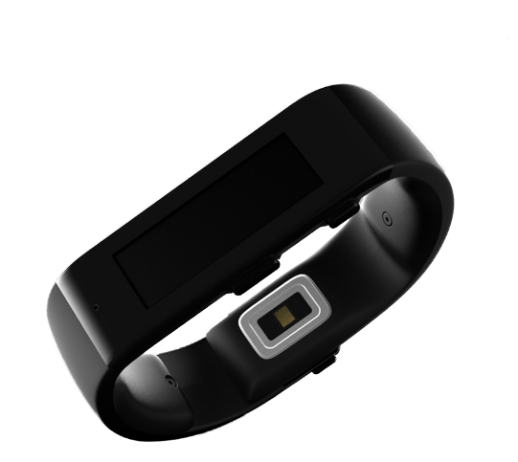




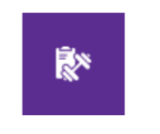
Health & Fitness
Far beyond a step tracker
Calculates activity level, heart rate metrics and sleep patterns
Steps, calories, distance, run, workout, bike, UV exposure.
Sleep duration, sleep efficiency, wakeup frequency and resting heart rate.
Guided routines for custom activity and workouts.

Slide 7
















Productivity
Rich notifications that drive user engagement
Band surfaces important information at the right time
Incoming calls, texts, social updates, weather, finance, and more.
Email previews and calendar alerts.
Cortana.

Slide 8
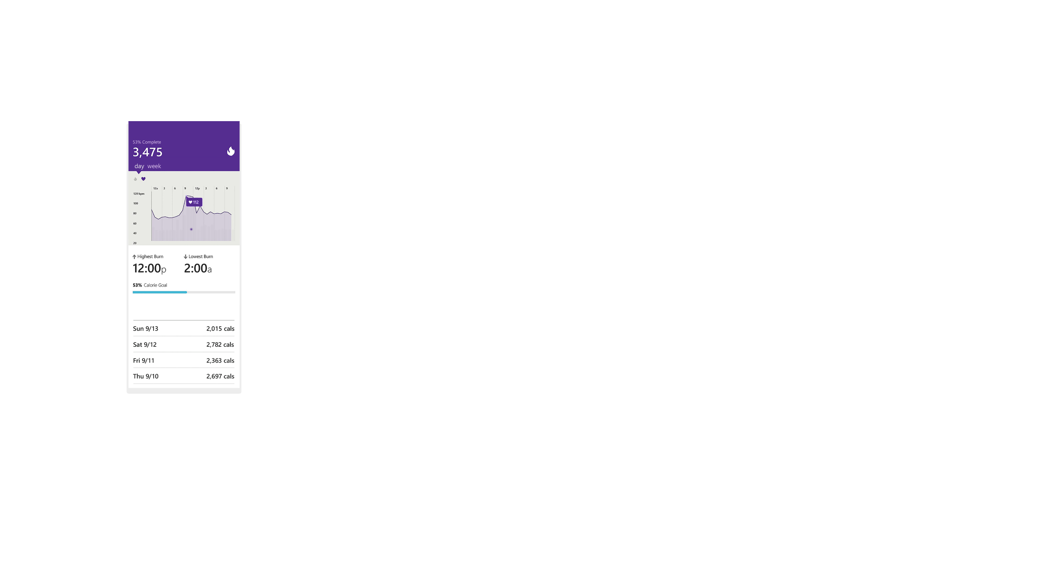
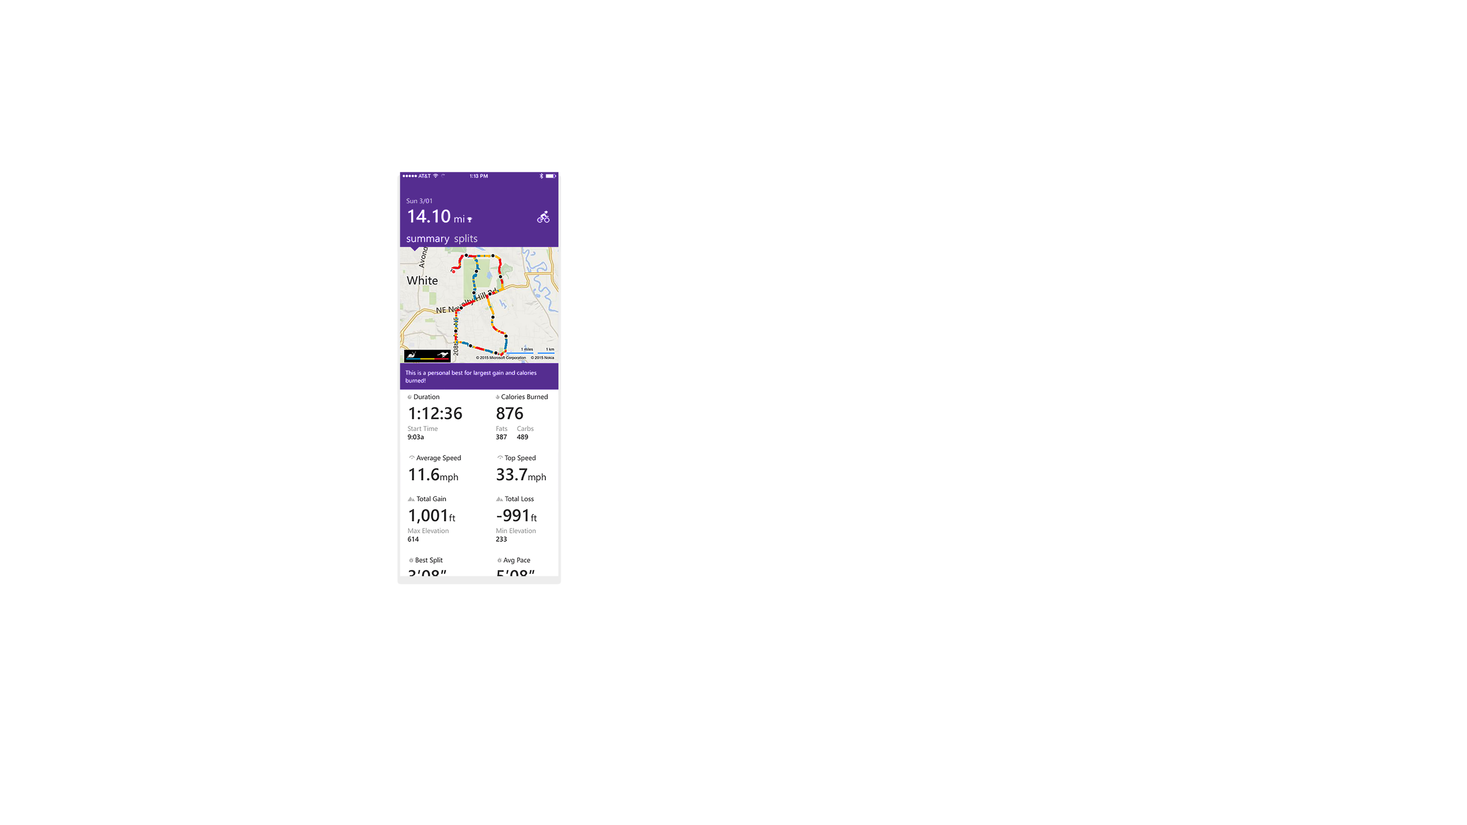
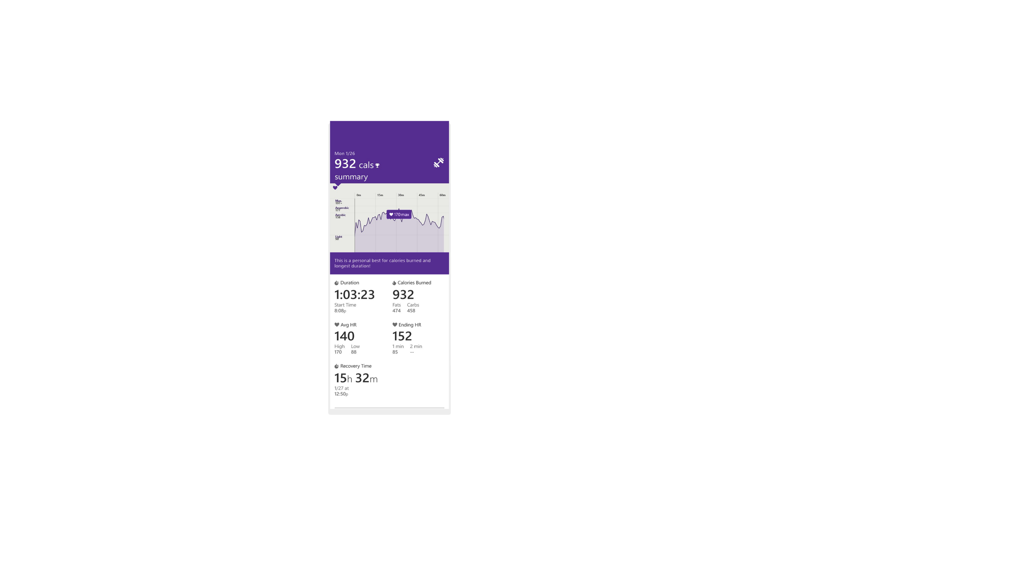
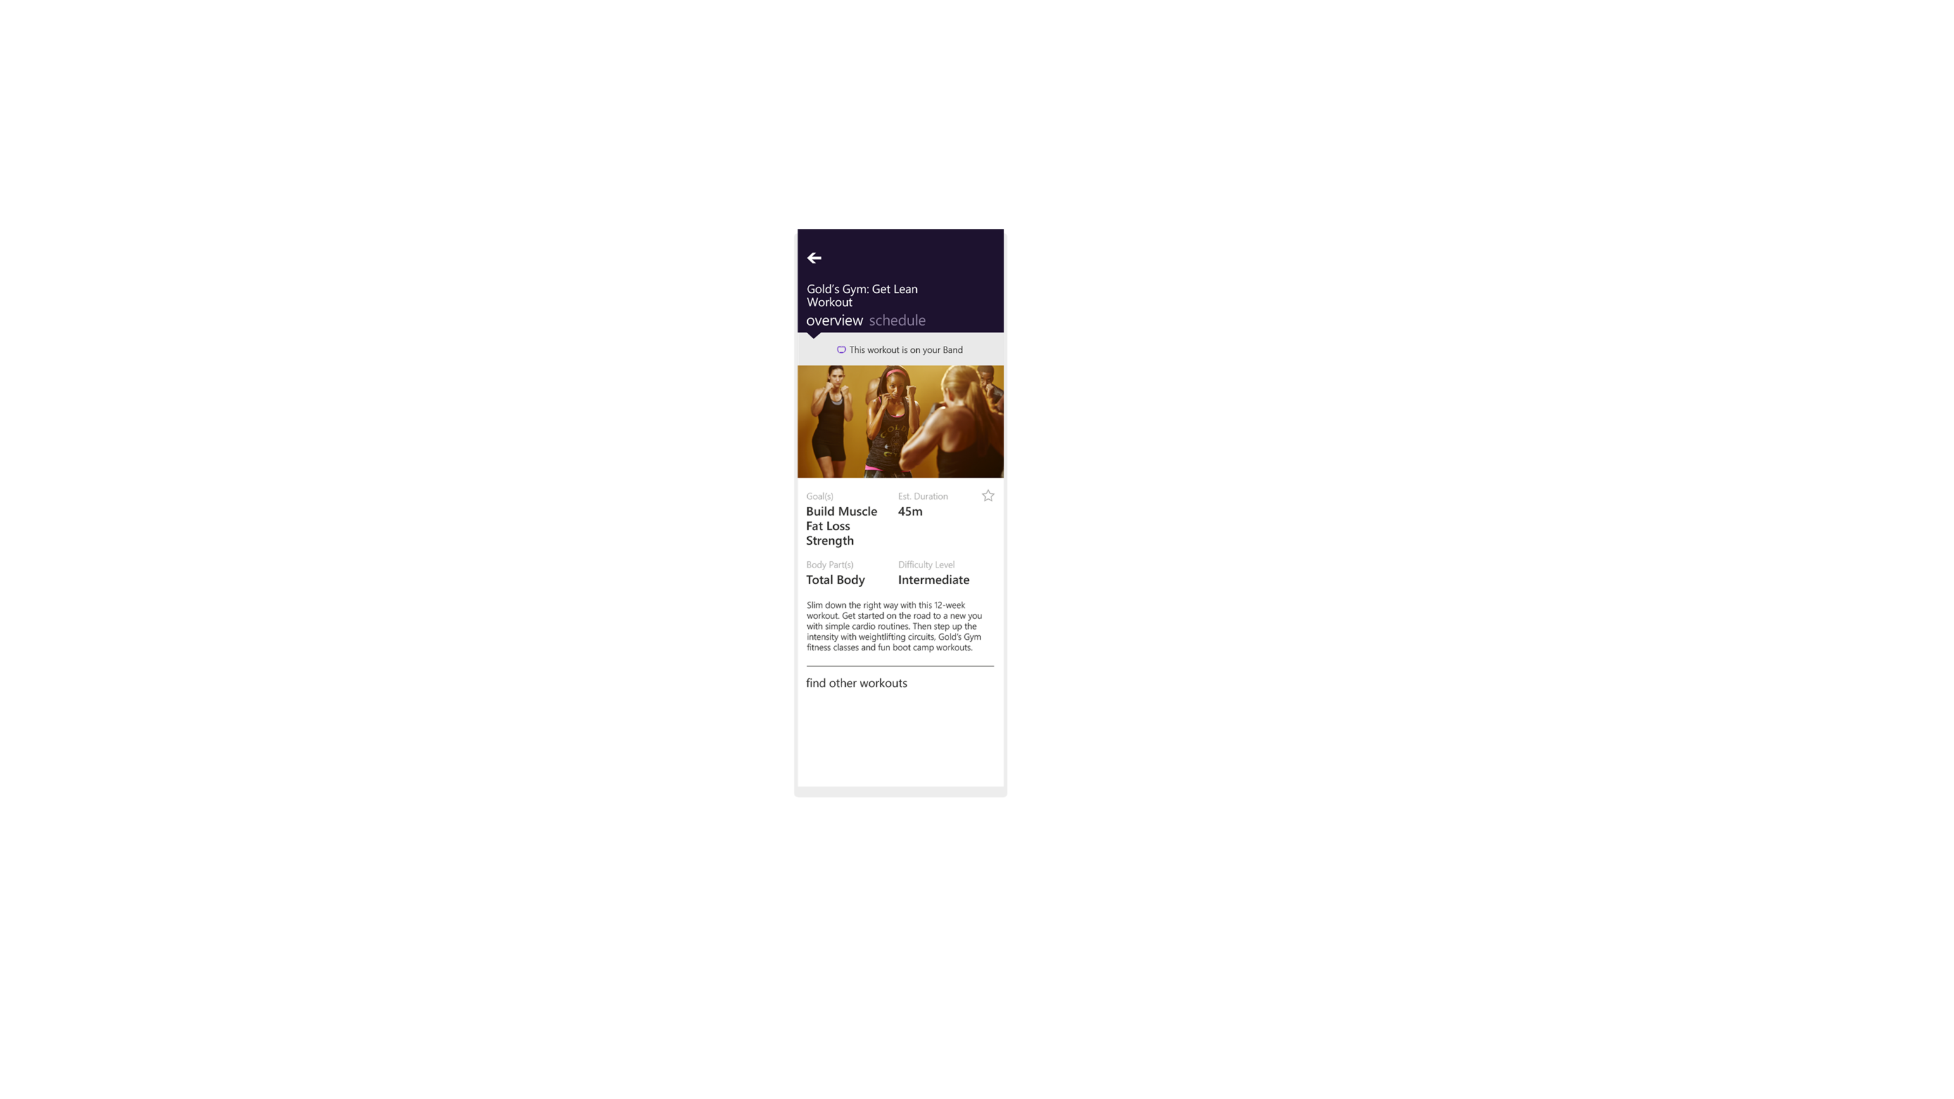
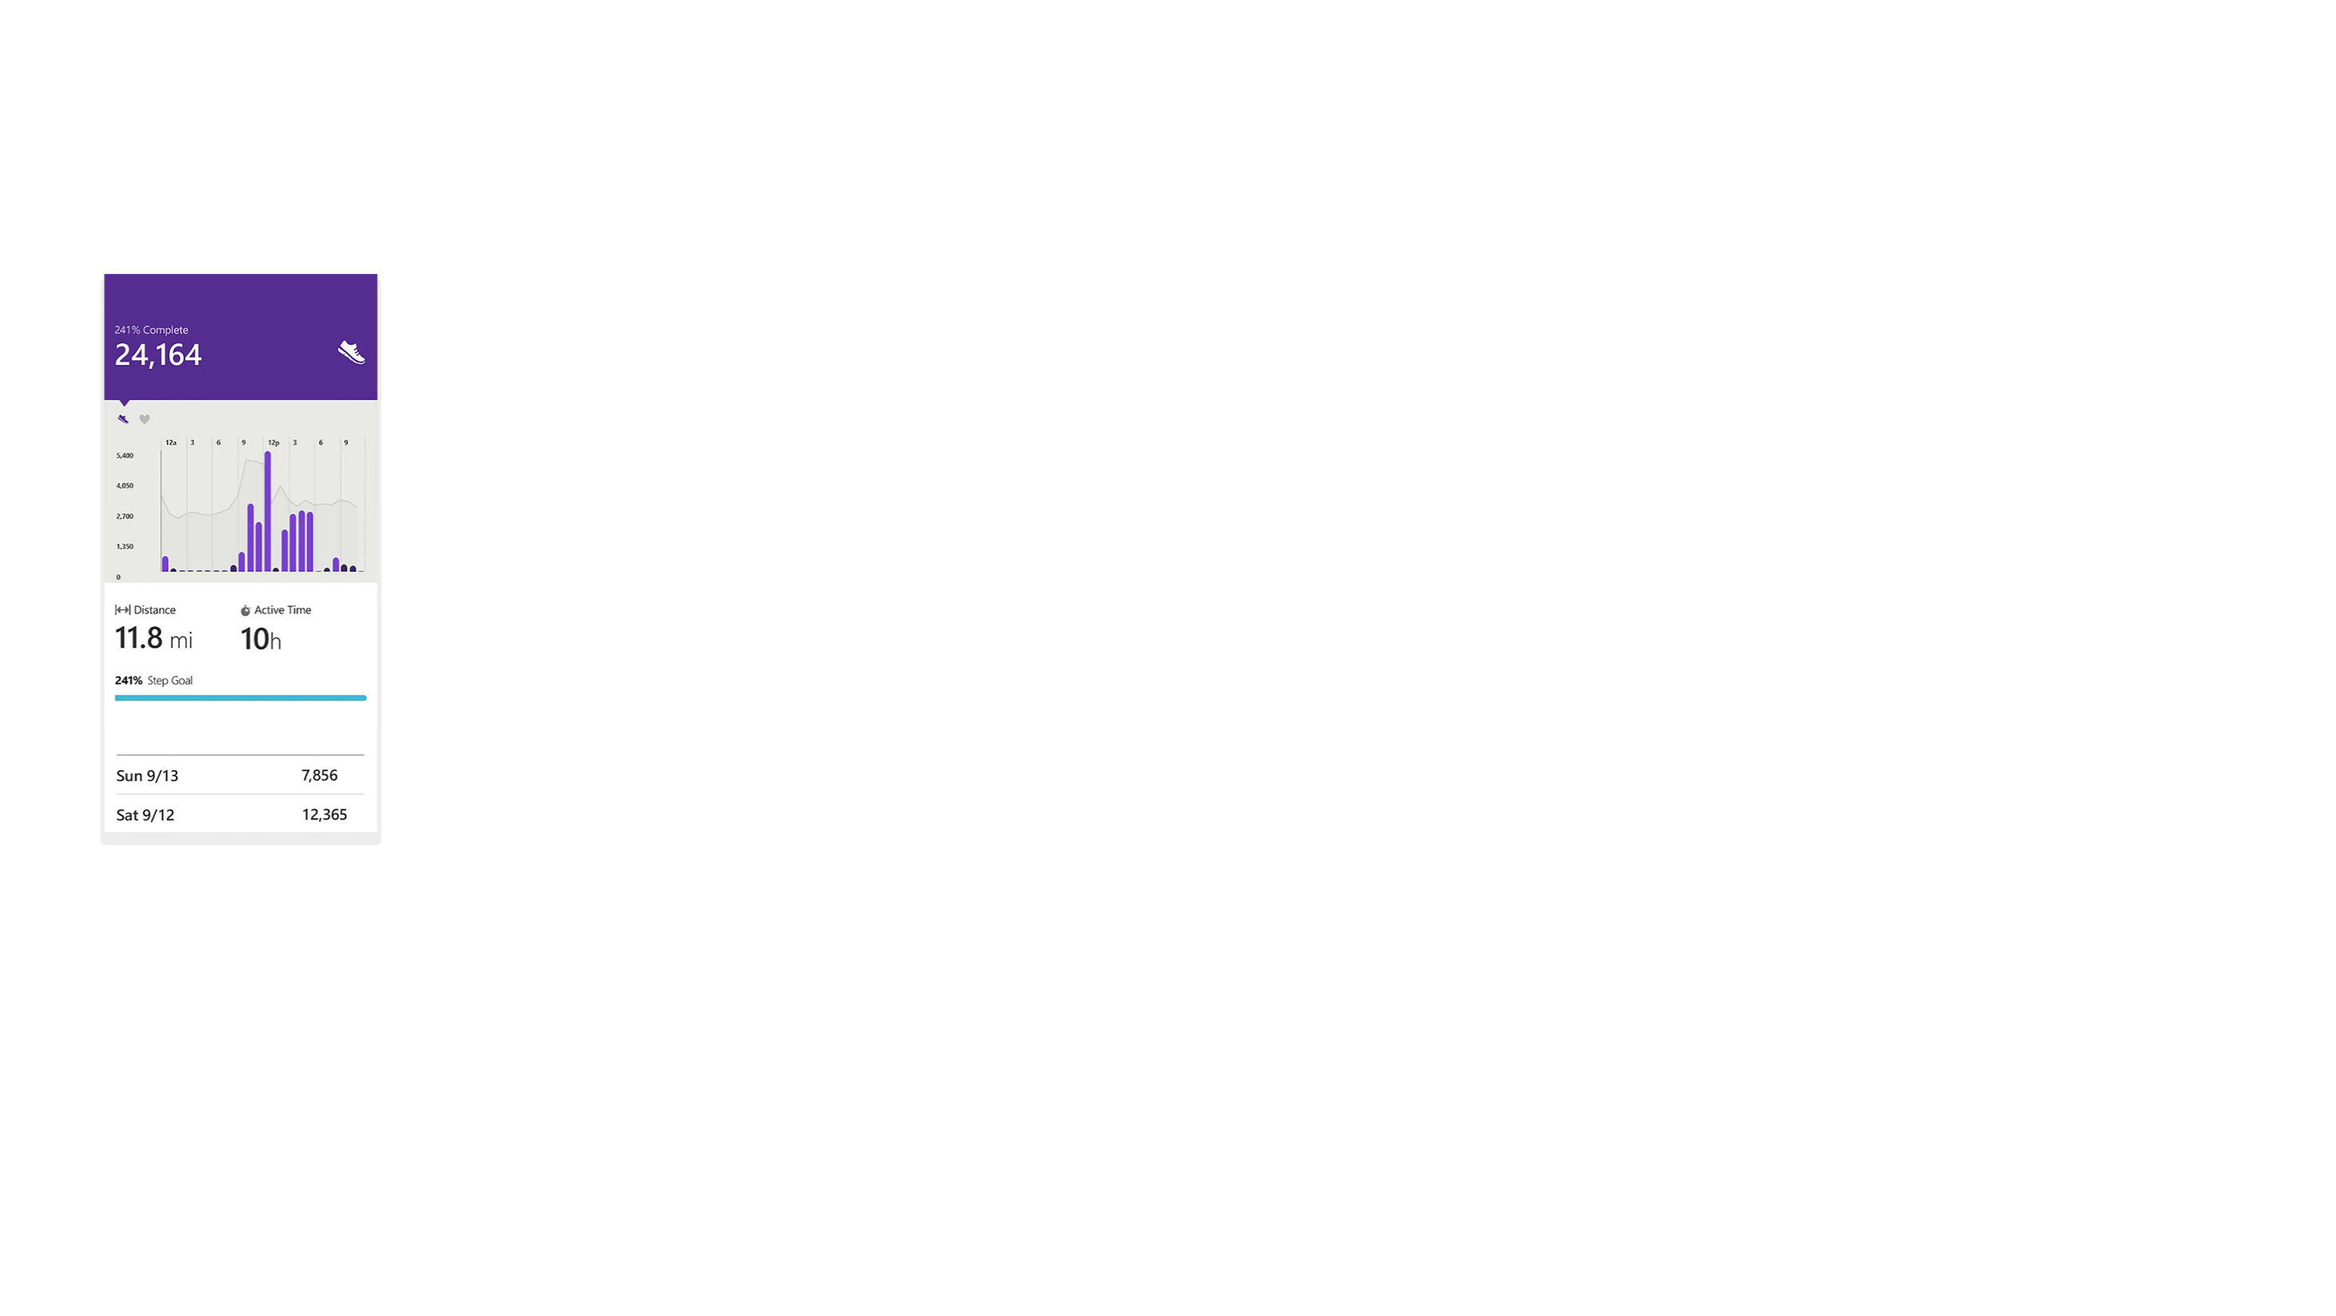
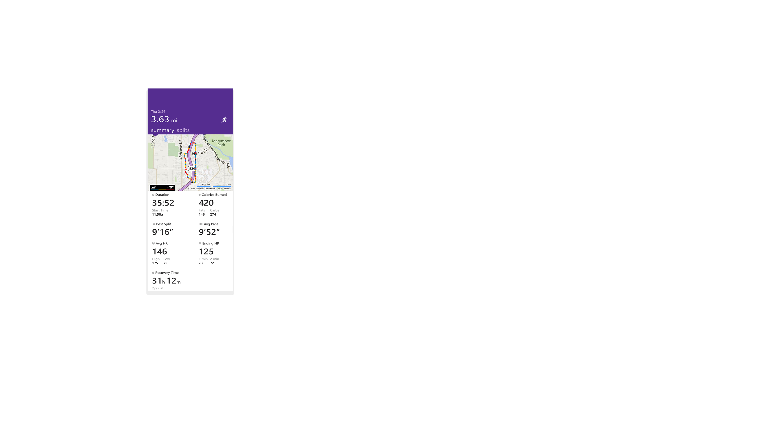
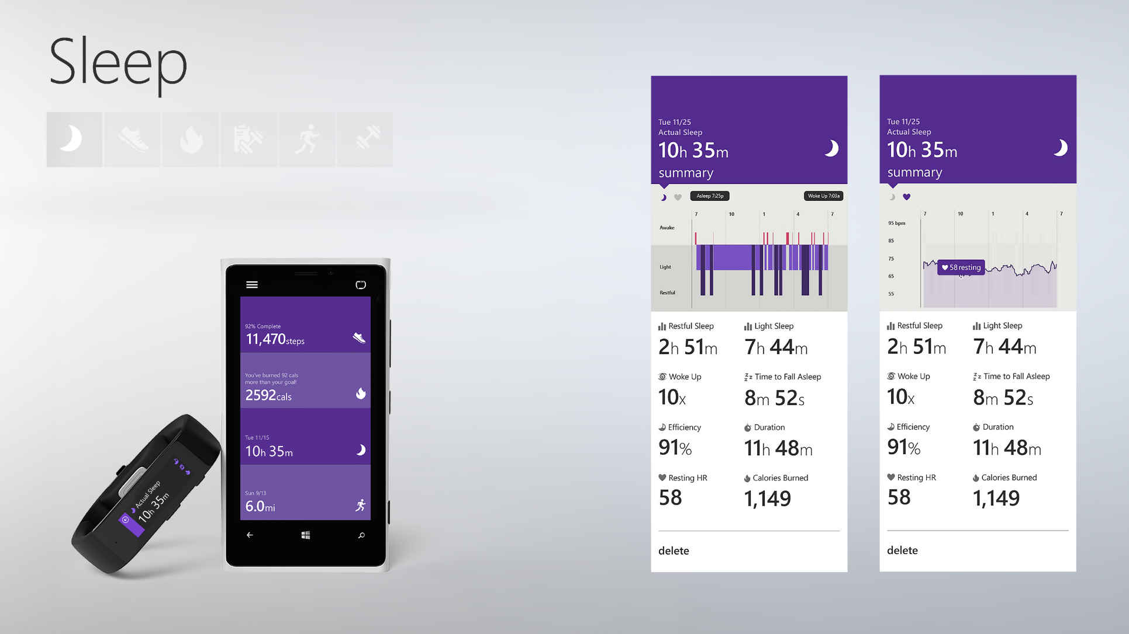
A holistic solution

Slide 9
Developers, developers, developers

Slide 10
Microsoft Band SDK
Libraries and components that allow applications to extend and enhance experiences with Microsoft Band.
Opens up Microsoft Band to applications
Band as a programming object
Microsoft.Band namespace for Windows, IBandClient represents a Band
3 main ways to interact
Stream data from Band’s sensors
Create interactive tiles
Personalize and customize
No application code runs on the Band
Band provides an extension model, not an application platform
Phone/Tablet/PC application is required
Use Band as an sensor rich input device and an auxiliary display

Slide 11
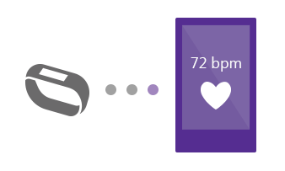
Stream sensor data
Subscribe to sensors
Receive data via events
Raw data as well as curated values

Slide 12
Types of subscriptions
using Microsoft.Band.Sensors
bandClient.SensorManager
Phone must be connected when streaming.
Some sensors require explicit user consent.
Battery impact for long running subscriptions.
Sensor | Measurement details | Frequency
Heart Rate | # of beats/min, reading quality | 1Hz
Accelerometer | X, Y and Z acceleration in g units | 8/30/60 Hz
Gyroscope | X, Y and Z angular velocity in degrees/sec units | 8/30/60 Hz
Distance | Total distance in cm, speed in cm/s, pace in ms/m, pedometer state | 1Hz
Pedometer | Total # of steps | Value change
Skin Temp | Current skin temperature in degrees Celcius | 1Hz
UV | Current UV radiation exposure intensity | 1Hz
Band Contact | Current worn/not worn state of the Band | Value change
Calories | Total # of calories | Value change

Slide 13
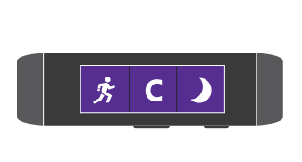
Create interactive tiles
Create your own tiles
Send notifications and dialogs
Create and send custom pages
Receive events

Slide 14
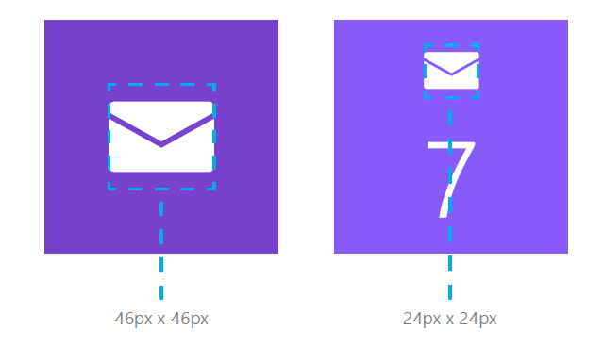
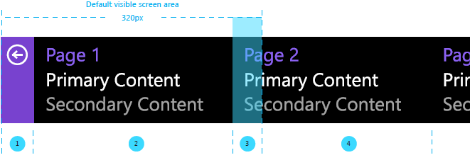
Creating tiles
using Microsoft.Band.Tiles
bandClient.TileManager
Apps can create 1 or more tiles.
Tile has a GUID, a tile icon, a badge icon.
Up to 8 additional icons for use within pages.
Tile can have up to 8 “Pages”.
Viewport for page content is 245 x 106 pixels.
Pages are either generic messages or built from custom layouts.

Slide 15
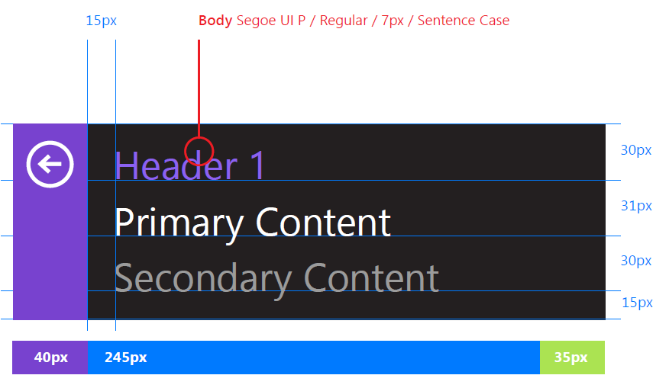
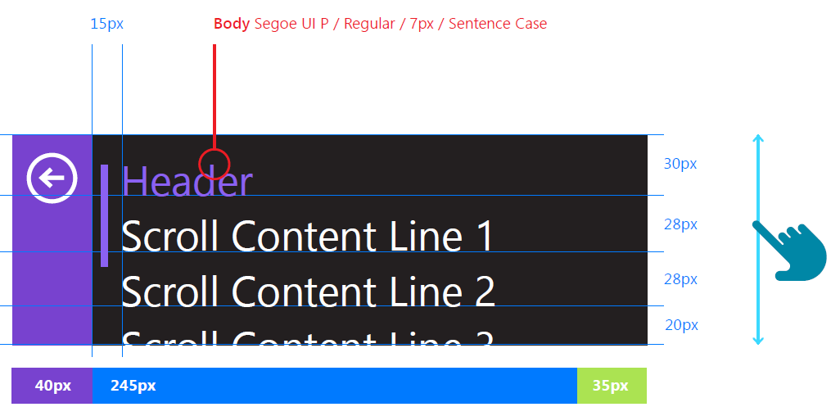
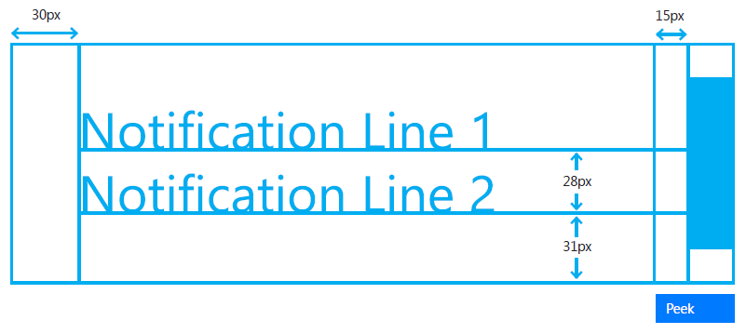
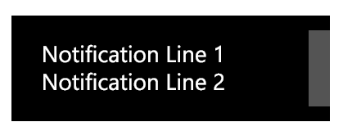

Notifications
using Microsoft.Band.Notifications
bandClient.NotificationManager
3 Types of Notifications
Messages
Title & body
Persist as pages inside the tile.
FIFO style queue of 8 messages at a time.
Dialogs
Pop up messages but do not persist inside the tile.
Haptic Alerts
Predefined vibration types.

Slide 16
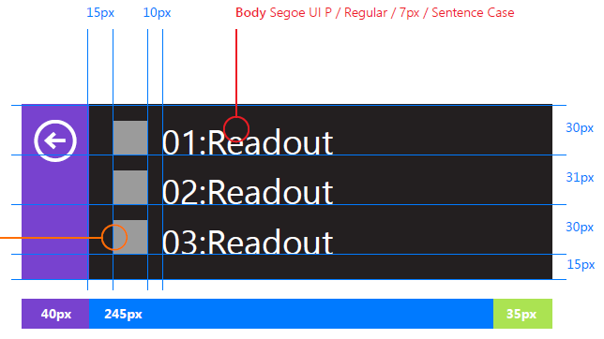
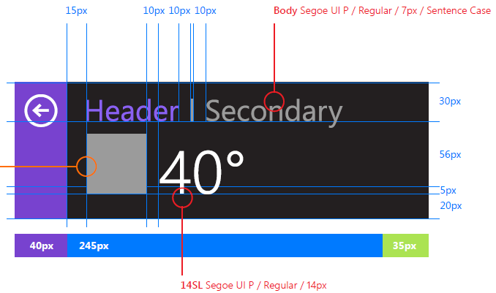
Custom layouts
using Microsoft.Band.Tiles.Pages
PageLayout
Tile can register up to 5 layouts.
Tree of container and primitive elements.
Container elements can have 1 or more container or primitive elements.
Primitive elements contain content.
Elements support positioning, formatting and styling.
Container Elements | Primitive Elements
FlowPanel | TextBlock
ScrollFlowPanel | WrappedTextBlock
FilledPanel | Icon
 | Barcode
 | TextButton
 | FilledButton

Slide 17
Receiving events from tiles
using Microsoft.Band.Tiles.Events
IBandTileEvent, IBandTileEventArgs
Each tile has 3 events you can subscribe to:
Tile Opened
Tile Closed
Button Pressed
Events are handled differently per platform
Android uses broadcast intents
Can invoke callback even when app is not running
iOS uses BLE custom characteristic
App in foreground or background
Windows uses direct communication
App code actively running
Windows 10 UWP App Services will allow non running apps to receive callbacks

Slide 18
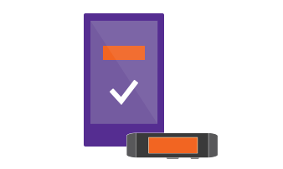
Personalize and customize
Change the “Me Tile” image
Change the theme color scheme for Microsoft Band

Slide 19
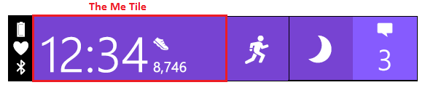
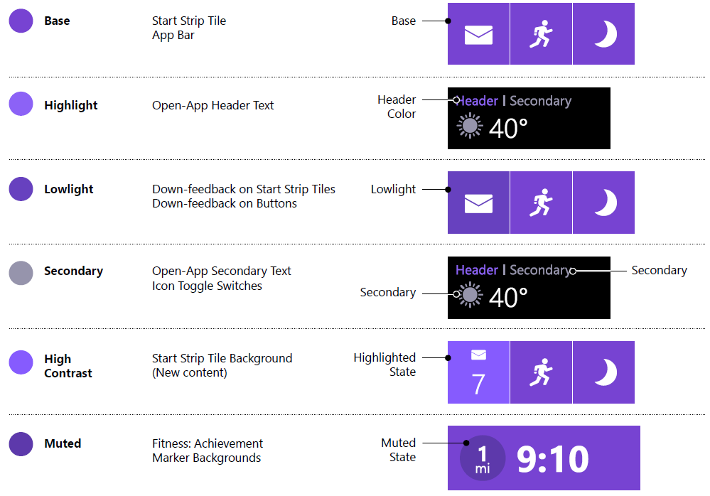
Personalize and customize
using Microsoft.Band.Personalization
bandClient.PersonalizationManager
Get and set MeTile image
310x102 pixels
Band theme has 6 different colors to represent various states of tiles and text

Slide 20
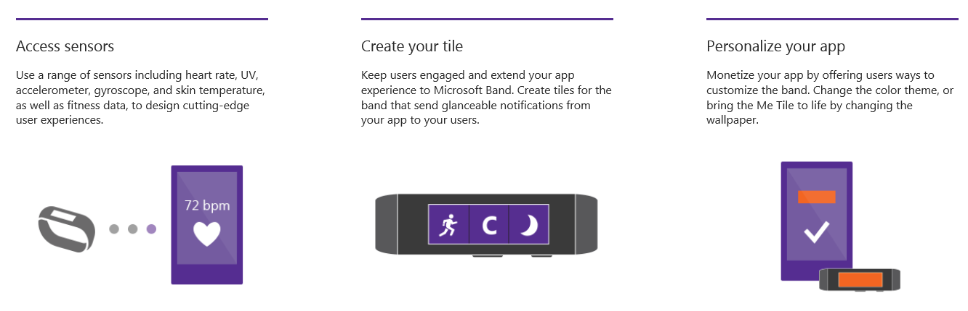


Microsoft Band SDK
http://developer.microsoftband.com/

Slide 21
Microsoft Health APIs
An open platform with RESTful APIs that allow developers to build smart applications based on fitness data.
View sensor data collected from Microsoft Band and other connected devices
Access and track user fitness history
Connect apps and services with Microsoft Health to collect activity summaries
Contribute data to Microsoft Health

Slide 22
Microsoft Health APIs
User profile information
Sensors
Summaries – hourly, daily, weekly, monthly for Steps, Calories, Distance, Heart Rate etc
Activities – Run, Bike, Workout, Guided Workout…
Sleep tracking – restful/light, efficiency, recovery
Connected devices

Slide 23
Where do we go now?
http://developer.microsoftband.com/
Download the SDK and documentation
Check out samples
Go develop!
http://www.microsofthealth.com/
http://www.microsoftband.com/
http://lumiaconversations.microsoft.com/
Blogs and news about upcoming features
healthms@microsoft.com
SDK questions and feedback

